Slide 1
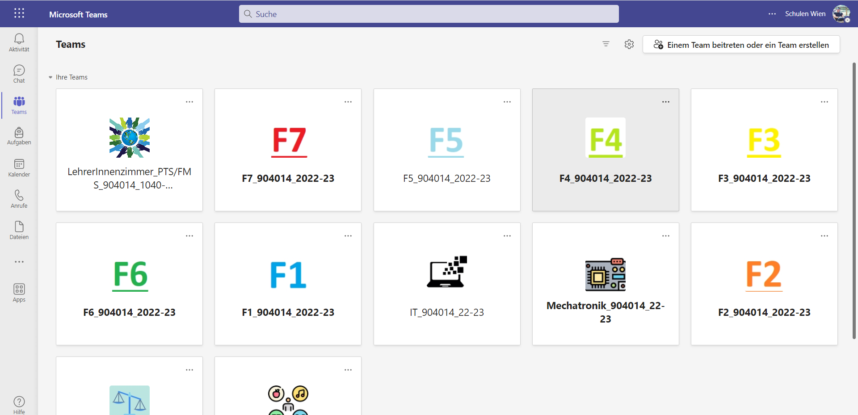

Slide 2
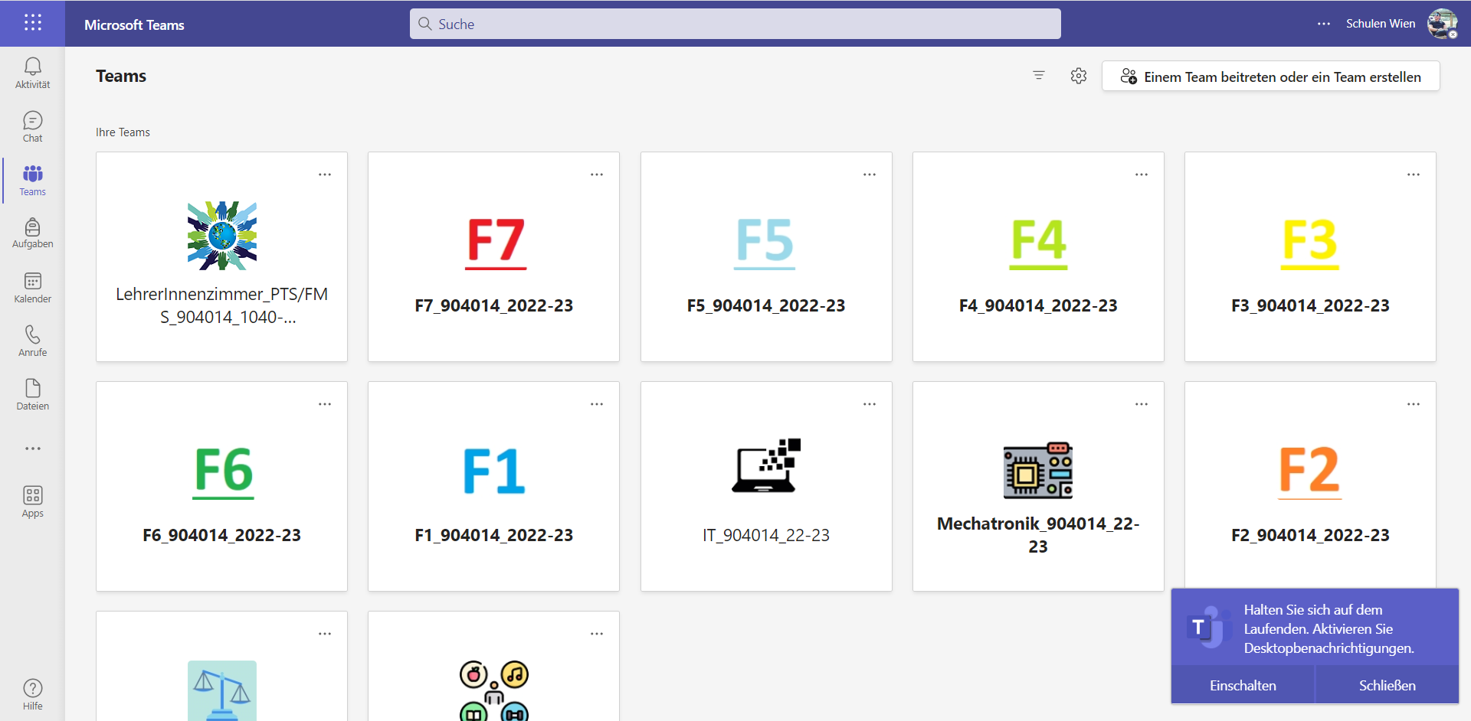

Slide 3
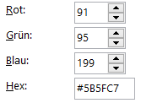
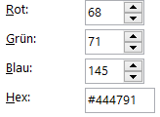
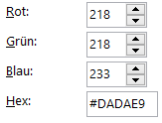
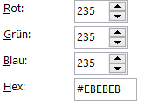


Slide 4

#5E5E5E
#444791
#5B5FC7
#F5F5F5

Slide 5
Side-icon
header-left
header-middle
header

Slide 6


#FDB913
#92C353

Slide 7

#F5F5F5

Slide 8
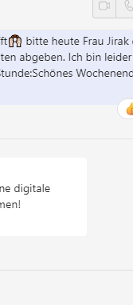
#E8EBFA
#F5F5F5

